Slide 1
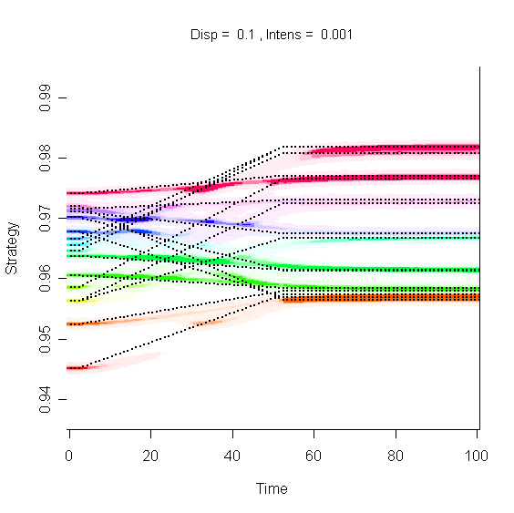
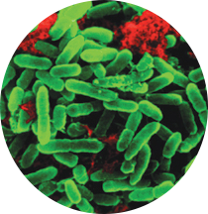
Species interactions and evolution
Tim Barraclough, t.barraclough@imperial.ac.uk
Notes:
Now onto the second half of my talk…don’t worry it’s a lot shorter!

Slide 2
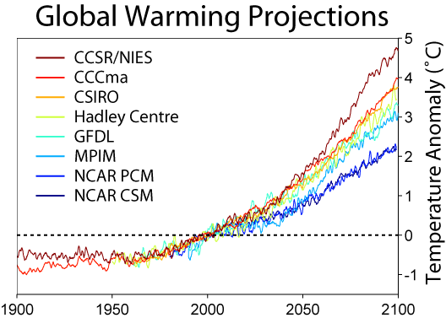
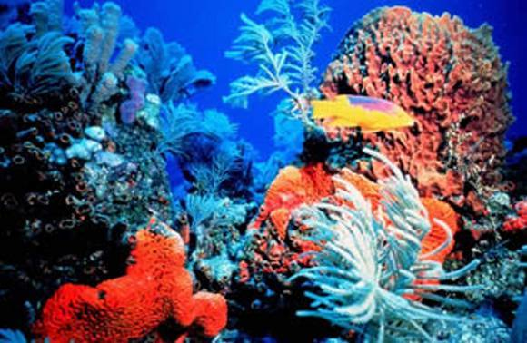
How do diverse communities respond to a new environment?
Notes:
Question is how does complex assemblage respond to change, e.g. global warming
Two types of response: how do these interact?
Largely kept separate, but how do they interact?

Slide 3


How do diverse communities respond to a new environment?

Slide 4


How do diverse communities respond to new conditions?
Ecological changes

Slide 5
How do diverse communities respond to new conditions?
Ecological changes Evolutionary responses

Slide 6
How do diverse communities respond to new conditions?
Ecological changes Evolutionary responses
How do species interactions affect evolution in communities?
How does evolution affect ecological interactions & functioning?

Slide 7
How do species interactions affect evolution?
Species interactions have negligible effect
Evolutionary rates across species depend on:
Generation time
Population size
Mutation rates
Recombination rates
Genetic variance-covariance conducive to selected change
Number of traits under selection
Size and temporal pattern of environmental change
Plasticity and ecological tolerance
Size of selective advantage of new mutations
History of past natural selection

Slide 8
How do species interactions affect evolution?
2) Species interactions affect population size

Slide 9
How does species diversity affect evolution?
2) Species interactions affect population size
Not clear that species in
more diverse communities
have lower genetic variation
Could predict evolution
with single species theory
if knew population sizes

Slide 10
3) Ecological sorting inhibits evolution
trait axis
trait axis

Slide 11
4) Coevolution promotes evolution
terHorst CP. 2010. Evolution in response to direct and indirect ecological effects in pitcher plant inquiline communities. Am Nat 176: 675-85

Slide 12
Qu. 1: How do species interactions affect evolution?
1) No effects of species interactions
2) Species interactions change population sizes and evolutionary rates
3) Ecological sorting inhibits evolution
4) Species interactions promote coevolution
5) Interference between adaptation to biotic and abiotic
6) Horizontal transfer promotes evolution
Can we produce general theory and evidence akin to single species?
Barraclough T.G. 2015. How do species interactions affect evolutionary dynamics across whole communities? Ann. Rev. Ecol. Evol. System.

Slide 13
Qu. 2: Does evolution affect functioning?
Enhances:
Species evolve new functions
Selection increases rate or efficiency of resource use
Specialisation increases collective use of resources
Impairs:
Species evolve to destabilize community, e.g. antagonism
No effect:
Functional redundancy or evolution constrained
Barraclough T.G. 2015. How do species interactions affect evolutionary dynamics across whole communities? Ann. Rev. Ecol. Evol. System.

Slide 14
A) Theory
Need model with the following features:
i) Set of co-occurring species (mechanism for coexistence)
ii) Species traits that determine match to environment
iii) Those traits can evolve (mutation)
iv) Change in environment

Slide 15
Discrete habitat patches linked by dispersal
hot
cold
De Mazancourt, Johnson, Barraclough 2008. Biodiversity inhibits species’ evolutionary responses to environmental change. Ecology Letters. 11:380-388.
Notes:
Consider patches, each with different temperature
Can have different species adapted to different patches,
Then warming of the environment
15

Slide 16
Discrete habitat patches linked by dispersal
hot
cold
De Mazancourt, Johnson, Barraclough 2008. Biodiversity inhibits species’ evolutionary responses to environmental change. Ecology Letters. 11:380-388.
Notes:
Consider patches, each with different temperature
Can have different species adapted to different patches,
Then warming of the environment. What happens?
Could disperse to new patches, or evolutionary response
16

Slide 17
De Mazancourt et al. 2008
Levene model with discrete habitat patches linked by dispersal
Optimum
Phenotype
X₁
Optimum
Phenotype
X₂
Optimum
Phenotype
X₃
Optimum
Phenotype
X₄

Slide 18
De Mazancourt et al. 2008
Levene model with discrete habitat patches linked by dispersal
Populate with species adapted to each habitat type
(stabilizing selection)
Optimum
Phenotype
X₁
Optimum
Phenotype
X₂
x₄
x₁
x₂
x₃
x₂
x₁
Optimum
Phenotype
X₃
Optimum
Phenotype
X₄
time
x₃
x₄

Slide 19
De Mazancourt et al. 2008
Levene model with discrete habitat patches linked by dispersal
Populate with species adapted to each habitat type
Change in environment; phenotype can evolve
Optimum
Phenotype
X₁
Optimum
Phenotype
X₂
X’₄
X₄
x₁
x₂
X’₂
X₃
X’₃
X₂
X’₁
X₁
Optimum
Phenotype
X₃
Optimum
Phenotype
X₄
time
x₃
x₄

Slide 20
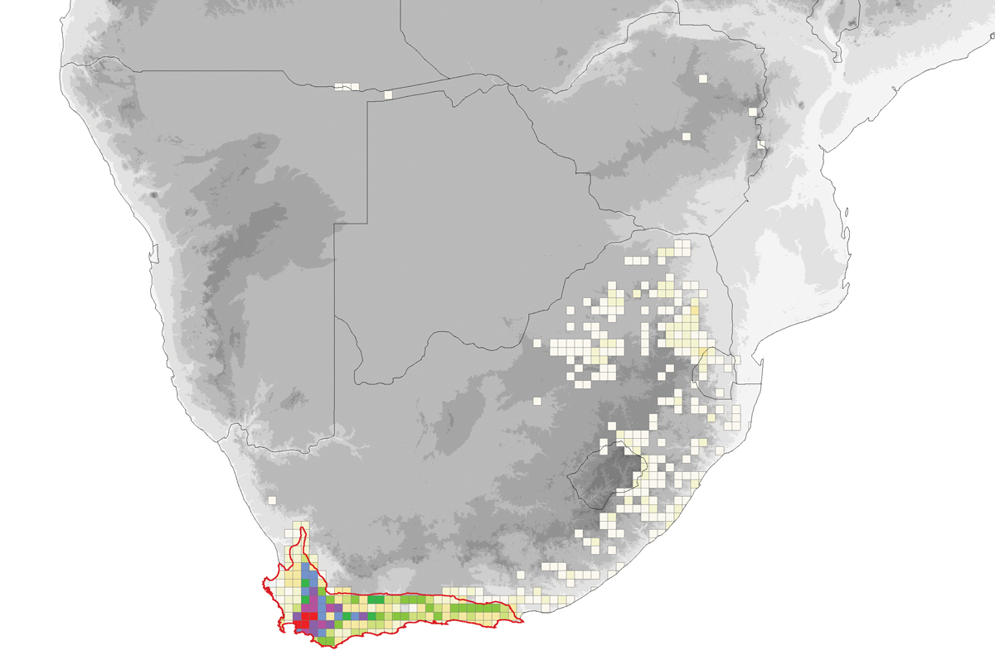
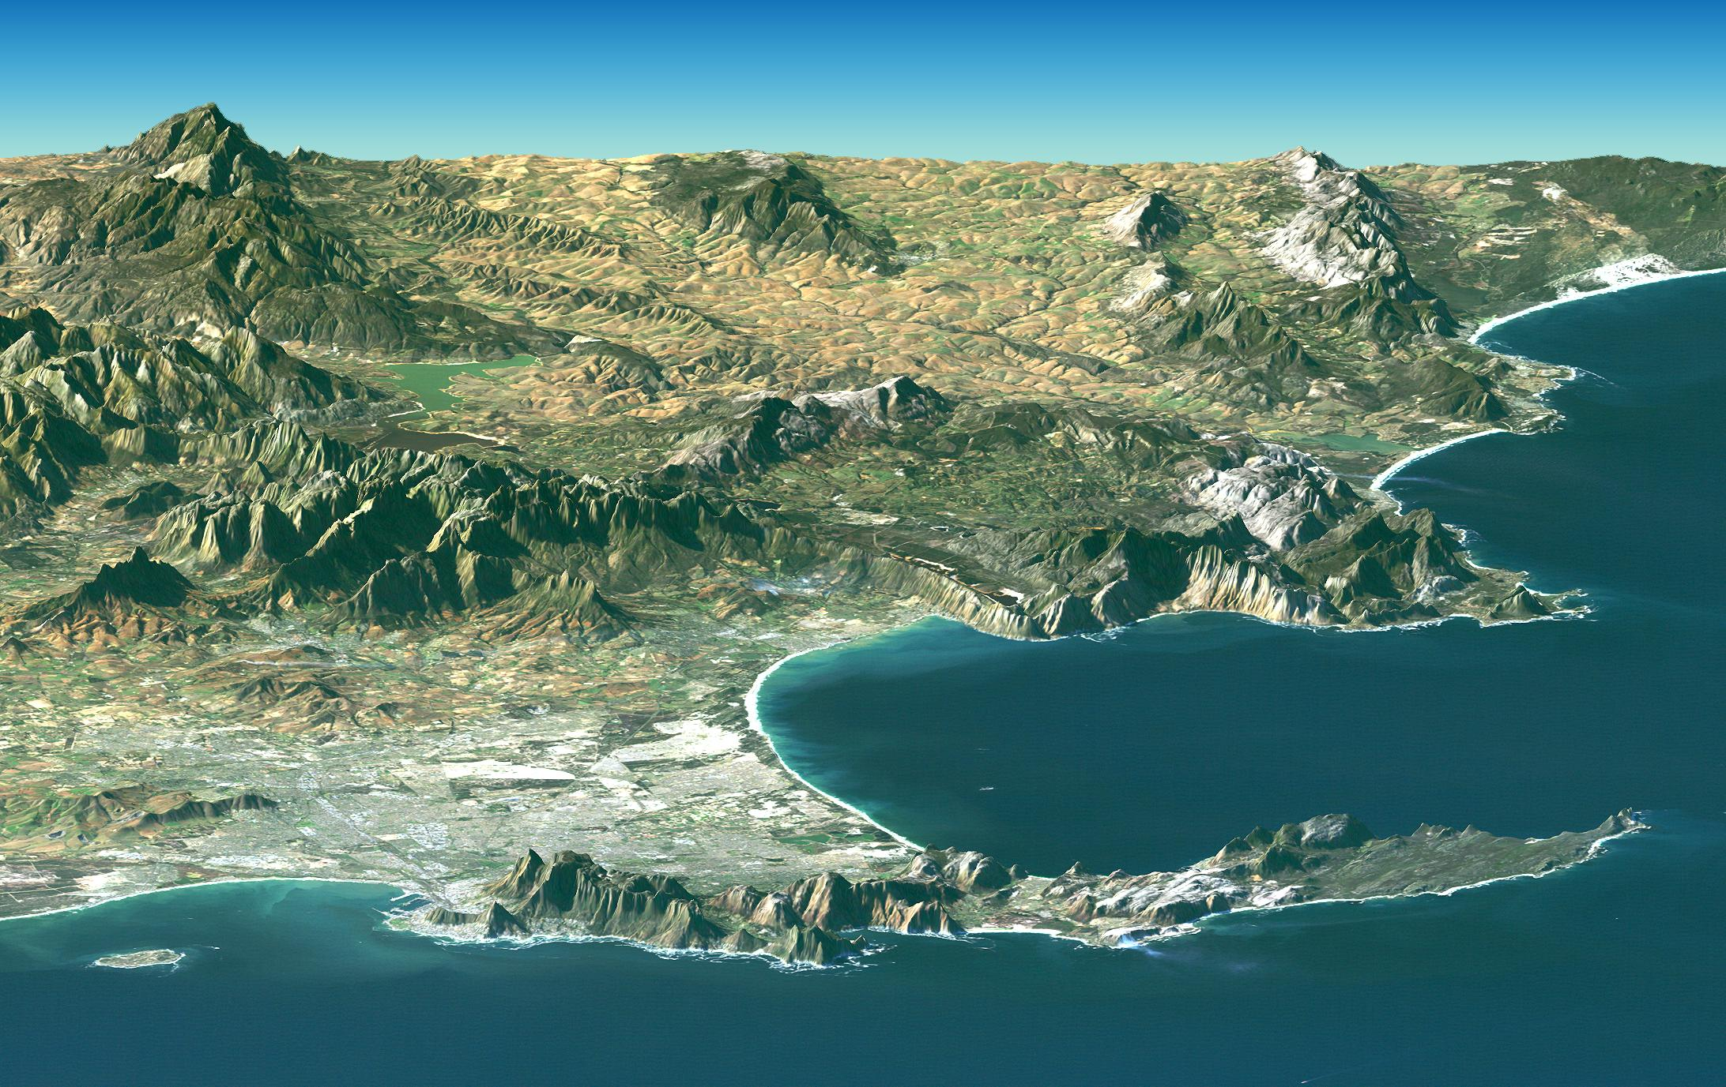
Hypothetical example: plant species inhabiting range of
habitats (relief; local water availability) in a region affecting
By global increase in temperature, decreased rainfall

Slide 21
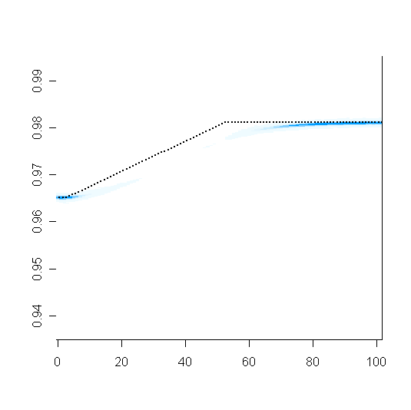
A) Single species in homogeneous environment
affected by global warming
T_{new}
Species adapts
- just!
Temperature
T_{old}
time
Blue = species phenotype
Dotted line = optimum phenotype, i.e. temperature of environment
Notes:
21

Slide 22
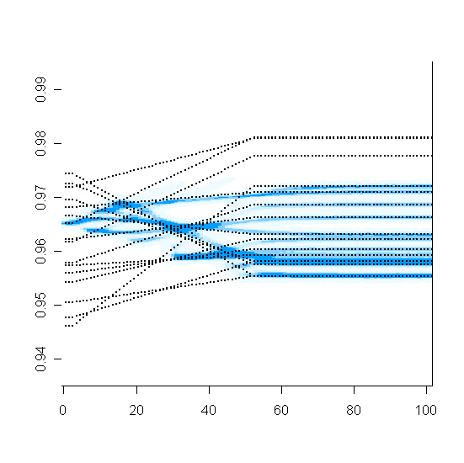
B) Same single species in patchy environment
affected by average global warming
Temperature
Species diversifies
time
Patches = microhabitats, e.g. shady and sunny sites for plants
Notes:
22

Slide 23
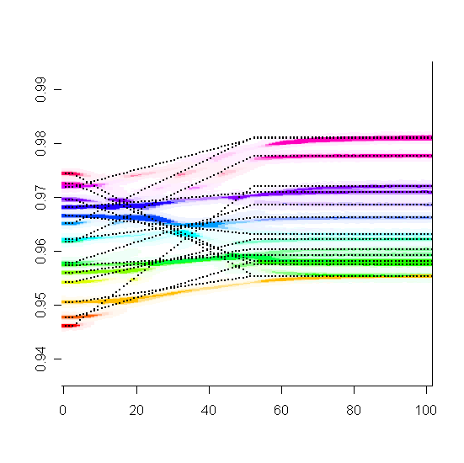
C) Multiple species in patchy environment
affected by average global warming
Species stay near original patch
ii) Diversity inhibits evolution
Temperature
time
Different colours = different species (16 altogether)
Notes:
23

Slide 24
Blue species inhibited to exhibit niche conservatism
X
X
Notes:
24

Slide 25
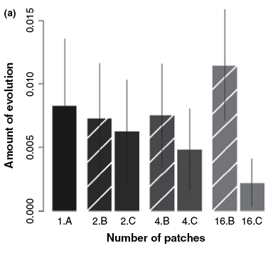
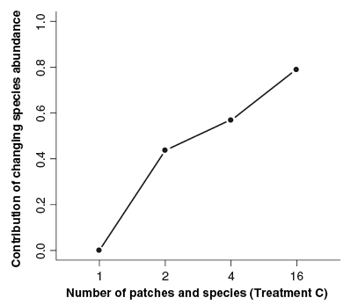
Conclusion:
Species diversity inhibits adaptation and diversification
Notes:
25

Slide 26



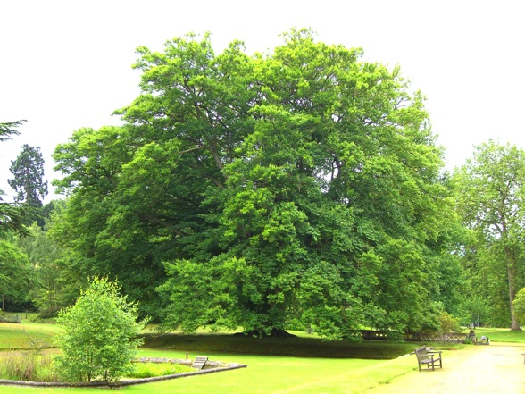

B) Evidence
Construct simplified communities,
manipulate conditions, track
evolution: experiments with
tree-hole bacteria
Bacteria from beach tree-holes:
culture on beech tea in the lab
rapid generation times
diverse communities

Slide 27
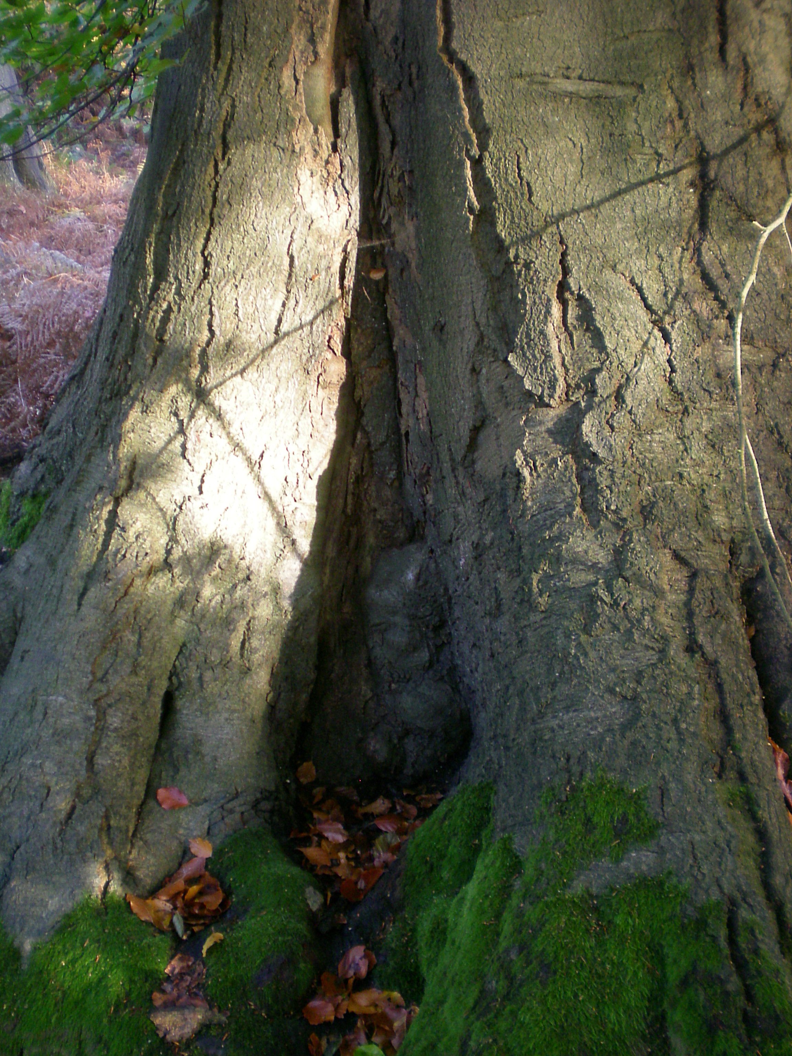
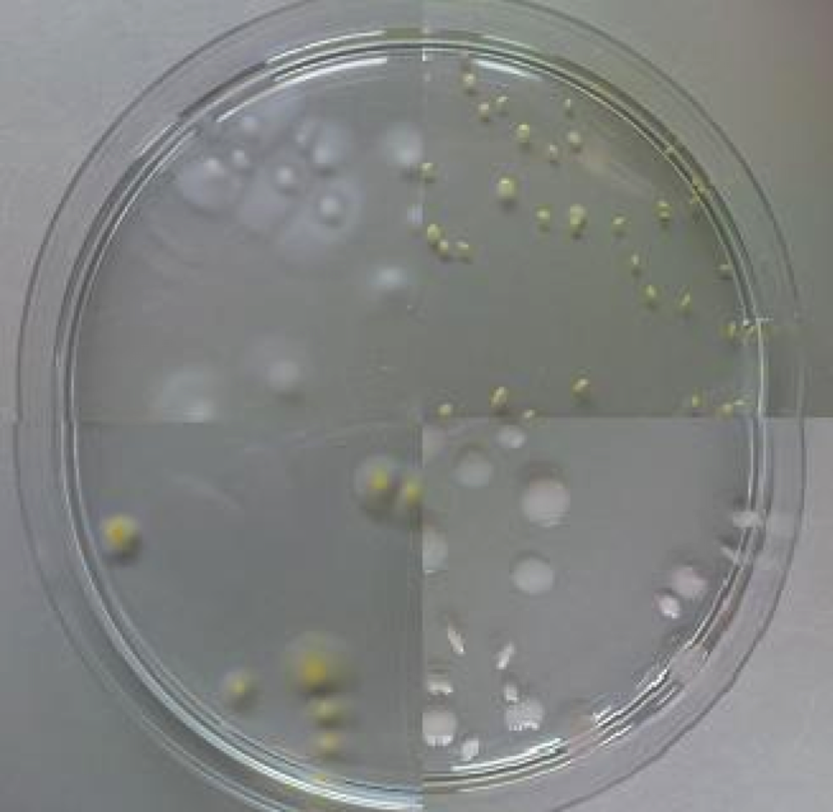
The Experiment:
1) Isolate species from tree-hole extracts
Species C
Species D
Species E
Species A

Slide 28
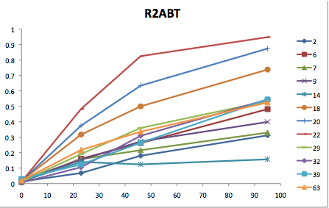
The Experiment:
1) Isolate species from tree-hole extracts
2) Choose 5 species that
grow in beech tea

Slide 29

The Experiment:
1) Isolate species from tree-hole extracts
2) Choose 5 species that
grow in beech tea
3) Store initial
strains at -80

Slide 30
The Experiment:
1) Isolate species from tree-hole extracts
2) Choose 5 species that
grow in beech tea
3) Store initial
strains at -80
4) Set up monocultures and species mixtures (5 spp)
4 replicates. Regular dilutions to maintain active growth

Slide 31
The Experiment:
1) Isolate species from tree-hole extracts
2) Choose 5 species that
grow in beech tea
3) Store initial
strains at -80
5) Have they adapted to lab beech tea?
4) Set up monocultures and species mixtures (5 spp)
Compare monoculture & polyculture?
4 replicates. Regular dilutions to maintain active growth

Slide 32
Measuring evolution and its consequences:
Growth rates on beech tea (abiotic conditions)
Growth rates on used beech tea (interactions)
NMR spectra of used and unused tea (resources)
Productivity of coevolved communities
Diane Lawrence et al. 2012. Species interactions alter evolutionary responses to environmental change. PLoS Biology 10: e1001330

Slide 33
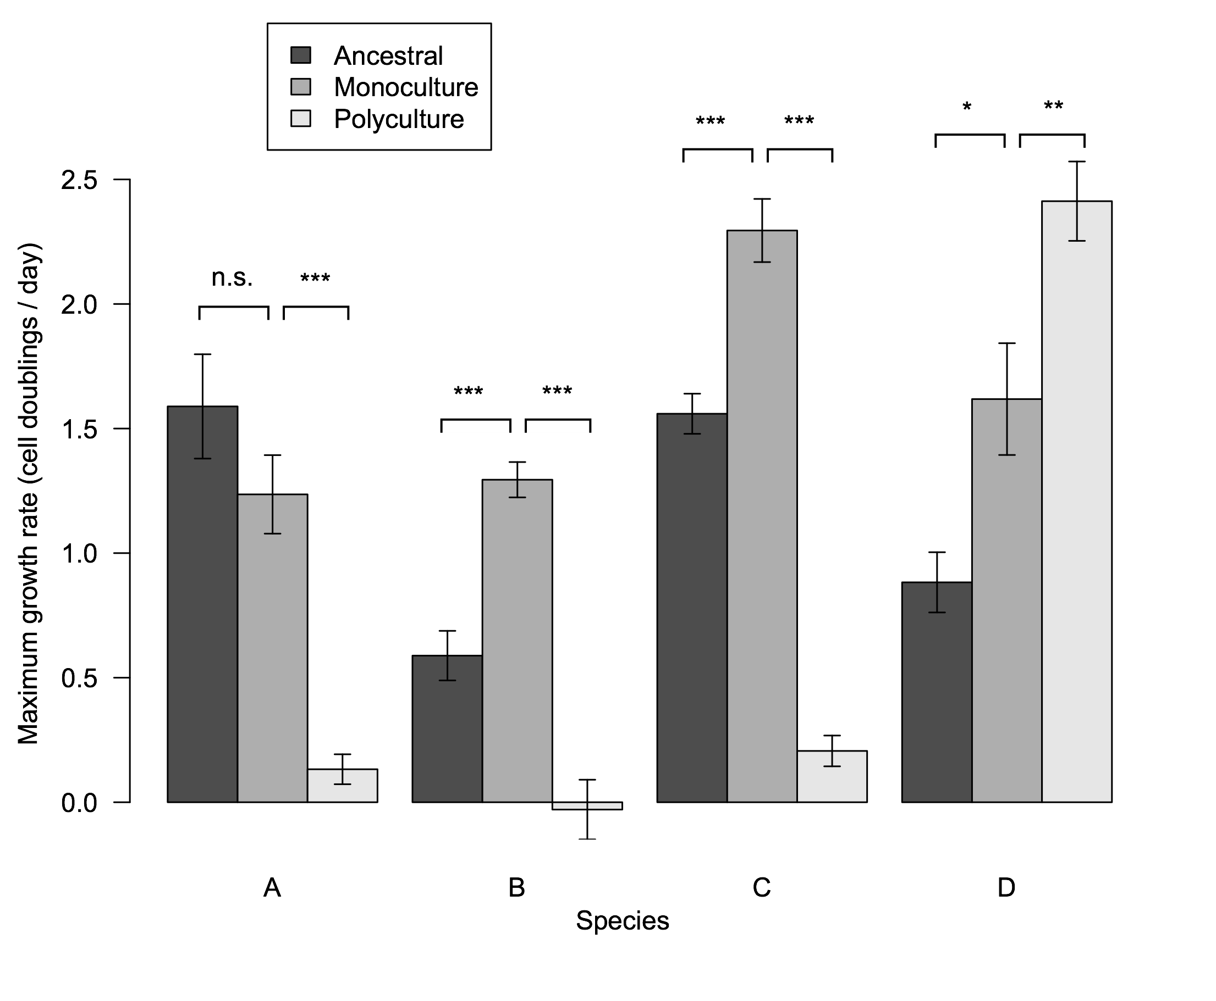
Adaptation to new environment
Growth rate of species from different treatments grown alone in beech tea

Slide 34
Adaptation to new environment
On average:
INCREASE in growth rate in MONOCULTURE

Slide 35
Adaptation to new environment
On average:
DECREASE in growth rate in POLYCULTURE

Slide 36
Conclusions
Trade-off between adapting to just physical environment and adapting to co-occurring species
How do species adapt to co-occurring species?

Slide 37
Evolution of species interactions
Grow bacteria on tea previously used by another bacterium
filter sterilise
Grow bacterium A Grow bacterium B
Negative interaction: grows worse than on raw tea
Positive interaction: grows better…

Slide 38
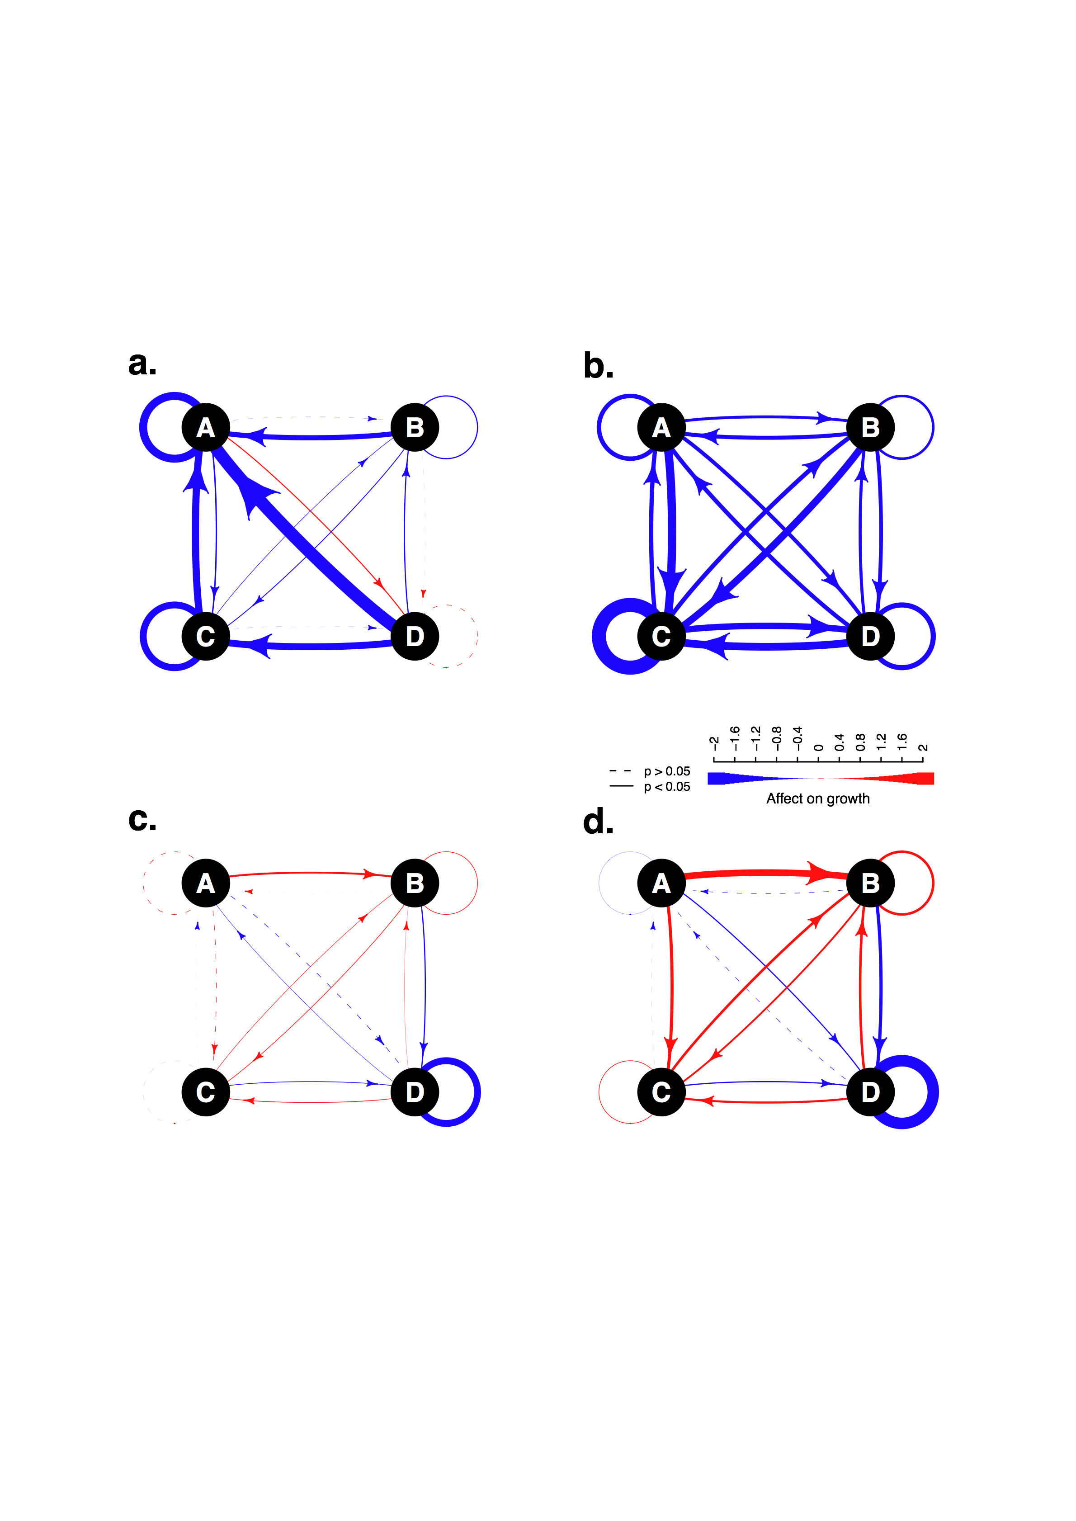
Evolution of species interactions
ANCESTRAL

Slide 39
Evolution of species interactions
ANCESTRAL
MONOCULTURE
Evolve to use similar resources

Slide 40
Evolution of species interactions
ANCESTRAL
MONOCULTURE
POLYCULTURE
Evolve to use similar resources
Evolve positive interactions:
Cross-feeding?

Slide 41
Conclusions
Trade-off between adapting to just physical environment and adapting to co-occurring species
Species in communities evolve more positive interactions
Metabolism or signaling molecules?

Slide 42
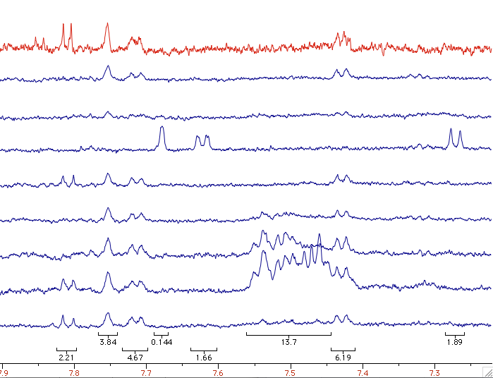
Analysis of Beech Tea
Unused beech tea
D
MONOCULTURE
C
B
A
D
C
ANCESTRAL
B
A

Slide 43
Analysis of Beech Tea
Unused beech tea
D
MONOCULTURE
C
B
A
D
C
ANCESTRAL
B
A

Slide 44
Analysis of Beech Tea
Unused beech tea
D
MONOCULTURE
C
B
A
D
C
ANCESTRAL
B
A

Slide 45
NMR results
Resource use
evolves
More in polyculture
than monoculture
Greater differences
among species

Slide 50
Species in polyculture evolved greater use of waste products being produced in greater amounts by other species

Slide 51
NMR results
More evolution in community than monoculture
Significant increase in variation in resource use
Evolved to use waste products of other species

Slide 52
Conclusions
Trade-off between adapting to just physical environment and adapting to co-occurring species
Species in communities evolve more positive interactions
Caused by evolving resource use

Slide 53
Conclusions
Species interactions increase amount of evolution and change direction => couldn’t predict from single species
Resource partitioning and cross-feeding
Resulting changes enhance ecosystem functioning
Diane Lawrence, Francesca Fiegna, Volker Behrends, Jacob Bundy, Albert Phillimore, Thomas Bell, Timothy Barraclough 2012. Species interactions alter evolutionary responses to environmental change. PLoS Biology 10(5): e1001330

Slide 54
Overall conclusions
Model: species interactions inhibit evolution of component species due to ecological sorting
Experiment: species interactions promote evolution due to resource partitioning and cross-feeding
Why different results?
What conditions promote each outcome?

